Slide 1


NEXT GEN EMPLOYABILITY PROGRAM
CREATING A FUTURE-READY WORKFORCE
Student Name :
VELAN M
Student ID :
STU649f97401a9bf1688180544
Mobile No:
9361814354
Mail ID:
velan00777@gmaill.com
College Name :
VAIGAI COLLEGE OF ENGINEERING

Slide 2
CAPSTONE PROJECT SHOWCASE
Project Title:
HEALTH CARE DATA DRIVEN DECISION MAKING
Abstract | Problem Statement | Project Overview | Proposed Solution | Technology Used | Modelling & Results | Conclusion | Q&A

Slide 3
Abstract
1
Data Collection and Preparation
2
Visualization and Dashboard Design
3
Analysis and Insights Generation
4
Iterative Development and Optimization

Slide 4


Problem Statement
In the rapidly evolving landscape of healthcare, organizations face numerous challenges in leveraging data effectively to drive informed decision-making and improve patient outcomes.
Despite the abundance of healthcare data generated from various sources such as electronic health records (EHRs), medical devices, and administrative systems, healthcare providers often struggle to extract actionable insights from this data due to disparate data sources, data silos, and complex data structures. As a result, healthcare organizations encounter inefficiencies in resource allocation, suboptimal clinical workflows, and gaps in patient care delivery.
The goal of this project is to develop a healthcare data analytics solution using Power BI that enables healthcare organizations to harness the wealth of data at their disposal to drive operational efficiency, clinical effectiveness, and patient-centric care delivery.

Slide 5

Project Overview
Project Introduction
Data Collection and Integration
Data Analysis and Visualization
Insights and Recommendations
Implementation and Deployment
Monitoring and Evaluation
Continuous Improvement

Slide 6
Proposed Solution
Enhanced operational efficiency through optimized resource allocation, streamlined workflows, and reduced administrative burden.
Improved clinical outcomes and patient satisfaction through evidence-based care delivery, personalized interventions, and proactive risk management.
Increased healthcare provider engagement and collaboration through data-driven decision-making and transparent performance monitoring.
Greater scalability and adaptability of the healthcare analytics solution to evolving healthcare challenges, technologies, and regulatory changes.

Slide 7

Technology used
POWER BI

Slide 8
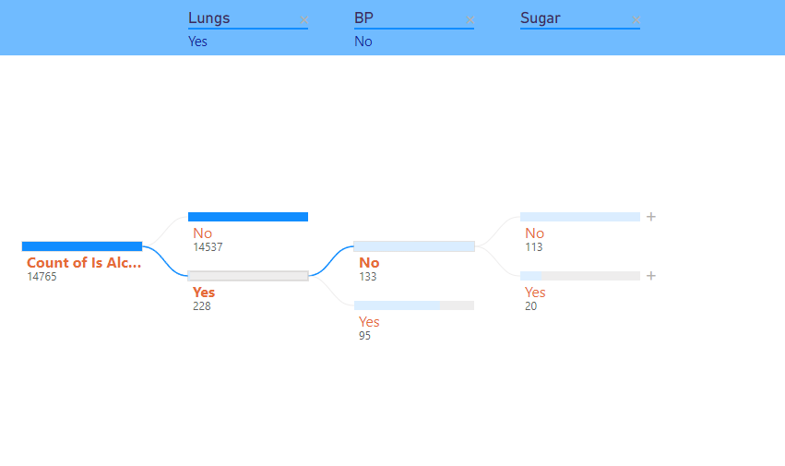
Modelling & Result
Decomposition tree view of patients who has lungs diseases, bp, Sugar.

Slide 9
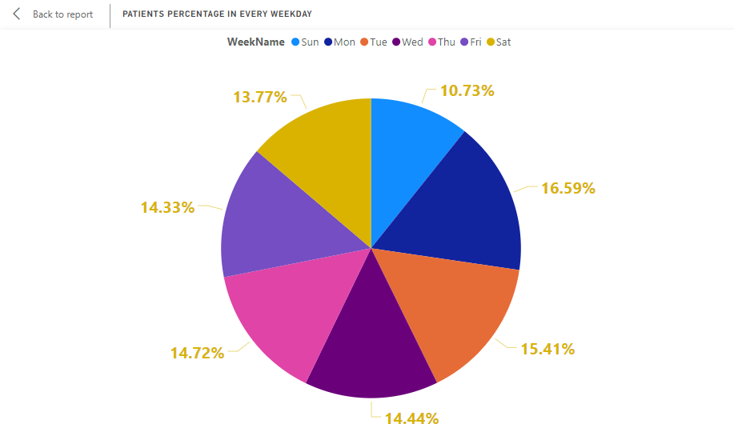
Modelling & Result
Percentage of patients in every week days
Sunday has less patients admission

Slide 10
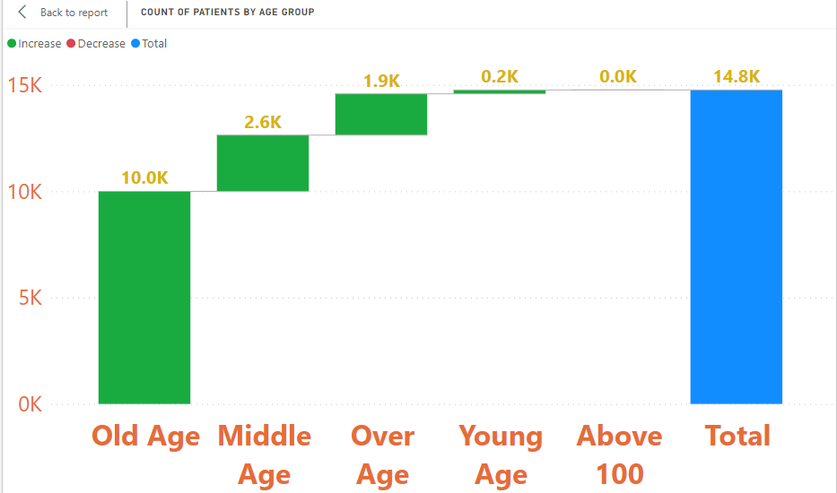
Modelling & Result
Waterfall chart of patients by age group
Old Age group people has admitted more than half of all other age group

Slide 11
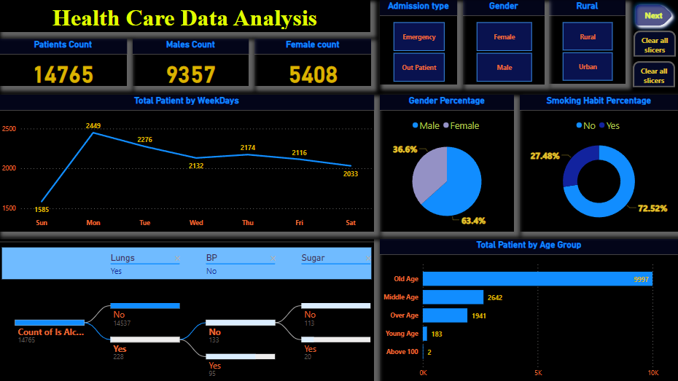
Modelling & Result [ Dashboard 1 ]

Slide 12
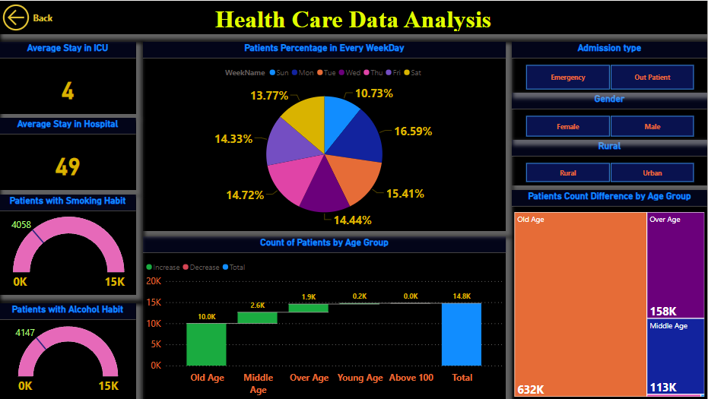
Modelling & Result [ Dashboard 2 ]

Slide 13

Conclusion
By harnessing the power of Power BI for healthcare data analysis, this project aims to drive meaningful improvements in patient care, operational efficiency, and decision-making effectiveness within healthcare organizations.
Through strategic utilization of data and analytics, we can unlock valuable insights that contribute to the advancement of healthcare delivery and outcomes.

Slide 14


Notes:
Thank You !!

